Slide 1

THE ROLLING SCOPES SCHOOL
Computer Networking
Emil Garipov

Slide 2


Introduction to Computer Networking
Key Components and Concepts
Devices: Devices are the physical entities that make up a network, including computers, laptops, servers, routers, switches, and wireless access points.
Network Interface: A network interface is a hardware or software component that enables a device to connect to a network.
Protocols: Protocols are a set of rules and standards that govern the communication between devices in a network. Examples of common protocols include TCP/IP, HTTP, and Ethernet.
IP Addressing: IP addressing is a fundamental concept in computer networking. It involves assigning unique numerical identifiers, known as IP addresses, to devices on a network.
Routing: Routing is the process of directing data packets from one network to another. Routers play a crucial role in routing by examining the destination IP address of a packet and determining the best path for its delivery.
Switching: Switching is the process of forwarding data packets within a network. Switches are responsible for directing packets to their intended destination within a local network based on the MAC addresses of devices.
Firewalls: Firewalls are security devices that monitor and control incoming and outgoing network traffic. They act as a barrier between internal and external networks, protecting against unauthorized access and potential threats.

Slide 3

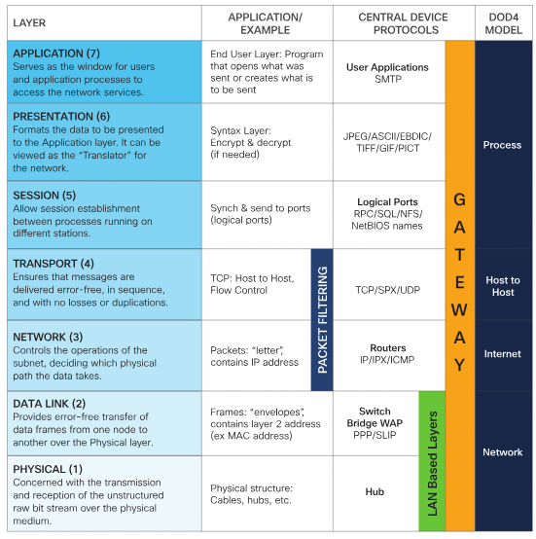
Overview of the OSI Model
OSI Layers
The Physical layer is responsible for the transmission and reception of raw data bits over a physical medium, such as copper wires or fiber optic cables.
The Data Link layer is responsible for the reliable transfer of data between adjacent network nodes. It provides error detection and correction, as well as flow control mechanisms to ensure data integrity.
The Network layer is responsible for the routing of data packets across multiple network nodes. It determines the optimal path for data transmission and handles addressing and logical network topology.
The Transport layer is responsible for the end-to-end delivery of data between source and destination hosts.
The Session layer is responsible for establishing, managing, and terminating sessions between applications.
The Presentation layer is responsible for the representation and transformation of data.
The Application layer is the topmost layer of the OSI model. It provides network services to end-user applications, such as email, web browsing, and file transfer.
Image downloaded from Cisco.com

Slide 4

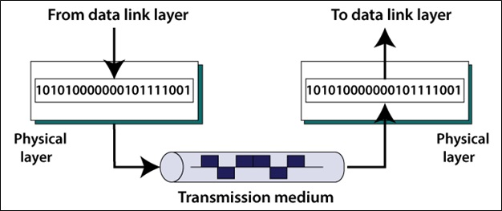
Layer 1: Physical Layer
Encoding and decoding: The Physical Layer converts digital data into a physical signal that can be transmitted over the network medium.
Physical media: This layer determines the type of physical media used for data transmission, such as copper cables, fiber-optic cables, or wireless communication. It defines the characteristics of the media, including the transmission speed, distance limitations, and signal quality.
Signal transmission: The Physical Layer ensures that the data signals are transmitted reliably from one device to another. It defines the electrical, optical, or radio characteristics of the signals, including the voltage levels, frequency, and modulation techniques.
Bit synchronization: The Physical Layer ensures that the sender and receiver devices are synchronized in terms of the timing and rate at which bits are transmitted. It establishes a clocking mechanism to ensure accurate data transmission.

Slide 5

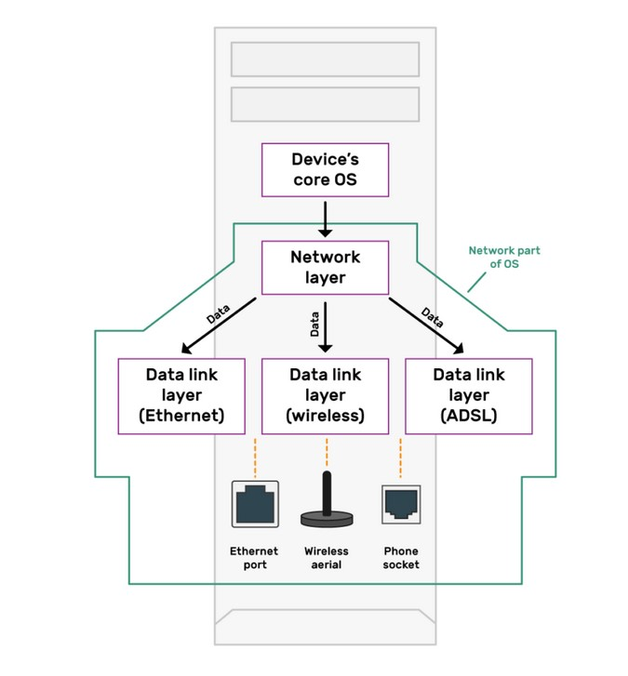
Layer 2: Data Link Layer
Framing: The Data Link Layer breaks the data received from the Network Layer into smaller units called frames. Each frame consists of a header, data, and a trailer. The header contains control information such as source and destination addresses, while the trailer includes error detection codes like cyclic redundancy check (CRC).
Physical Addressing: The Data Link Layer assigns unique physical addresses, known as Media Access Control (MAC) addresses, to each device on a network. MAC addresses are used to identify the source and destination devices within a local network.
Error Detection and Correction: The Data Link Layer ensures the integrity of data transmission by detecting and correcting errors that may occur during transmission. It uses error detection techniques like CRC to identify errors in the received frames. If errors are detected, the Data Link Layer can request retransmission of the corrupted frames.
Flow Control: The Data Link Layer manages the flow of data between two devices to prevent overwhelming the receiving device. It uses flow control mechanisms such as sliding window protocol to regulate the rate of data transmission and ensure that the receiving device can handle the incoming data.
Access Control: The Data Link Layer controls access to the physical medium when multiple devices are connected to the same network. It employs protocols like Carrier Sense Multiple Access with Collision Detection (CSMA/CD) or Carrier Sense Multiple Access with Collision Avoidance (CSMA/CA) to avoid collisions and manage the sharing of the network medium.

Slide 6

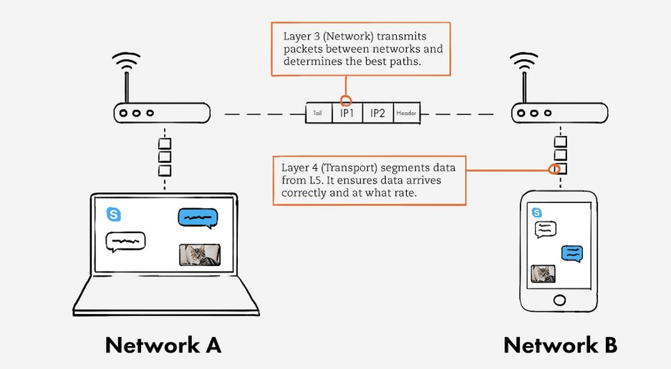
Layer 3: Network Layer
Logical Addressing: The Network Layer assigns logical addresses, such as IP addresses, to devices connected to a network. These addresses uniquely identify each device and are used for routing data packets.
Routing: Routing involves determining the best path for data packets to travel from the source device to the destination device across multiple networks. The Network Layer uses routing protocols, such as OSPF (Open Shortest Path First) or BGP (Border Gateway Protocol), to make routing decisions based on factors like network congestion, cost, and reliability.
Packet Fragmentation and Reassembly: The Network Layer is responsible for breaking down large data packets into smaller units, known as fragments, to facilitate transmission across networks with different maximum transmission unit (MTU) sizes. At the destination, these fragments are reassembled into the original packet.
Quality of Service (QoS): The Network Layer can prioritize certain types of traffic over others by implementing QoS mechanisms. This ensures that critical data, such as real-time video or voice, receives preferential treatment in terms of bandwidth allocation and latency.
Network Address Translation (NAT): NAT is a technique used by the Network Layer to translate private IP addresses used within a local network into a public IP address that can be recognized and routed on the internet. This allows multiple devices within a network to share a single public IP address.

Slide 7
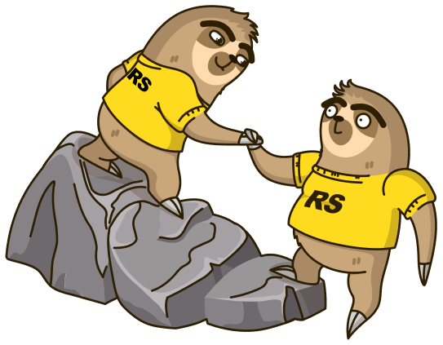
Layer 4: Transport Layer
Segmentation
One of the key functions of the Transport Layer is to break down the data received from the upper layers into smaller units called segments.
Reassembly
On the receiving end, the Transport Layer reassembles the received segments into the original data stream. This ensures that the data is delivered to the correct application in the correct order.
Error Detection
To ensure the integrity of the data being transmitted, the Transport Layer performs error detection. It adds checksums to the segments, which are used to detect any errors that may have occurred during transmission.
Error Recovery
In case errors are detected, the Transport Layer is responsible for recovering the lost or corrupted data. It achieves this through retransmission of the lost segments or by requesting the sender to resend the data.
Flow Control
Flow control is another important aspect of the Transport Layer. It manages the rate at which data is transmitted between the sender and receiver to prevent overwhelming the receiving system. By regulating the flow of data, the Transport Layer ensures that the receiving system can handle the incoming data without causing congestion or loss of data.

Slide 8

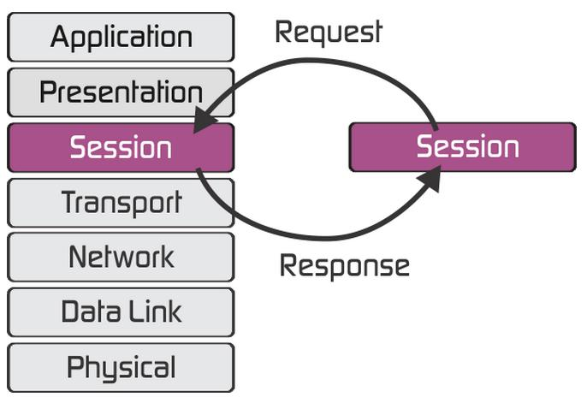
Layer 5: Session Layer
Session Identification: The Session Layer assigns a unique identifier to each session, allowing devices to differentiate between multiple concurrent sessions.
Dialog Control: The Session Layer manages the dialog between applications by establishing rules for who can send data and when. It ensures that only one device can transmit at a time to avoid data collisions.
Token Management: In some cases, the Session Layer uses tokens to control access to the session. Only the device holding the token can transmit data, ensuring fair and orderly communication.
Session Recovery: The Session Layer provides mechanisms for recovering from failures during a session. It allows devices to resume communication from the point of failure, minimizing data loss and ensuring reliable delivery.
Session Security: The Session Layer can implement security measures such as encryption and authentication to protect the session from unauthorized access and ensure data confidentiality.

Slide 9

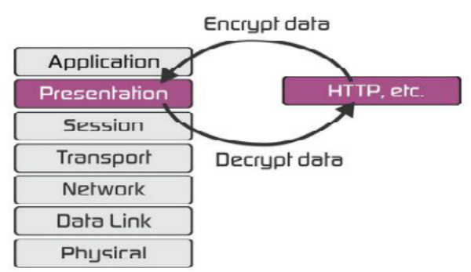
Layer 6: Presentation Layer
Data Translation: This layer is responsible for translating data from the format used by the sending system into a format that can be understood by the receiving system. It handles any necessary data conversion and character encoding.
Data Encryption and Decryption: The Presentation Layer provides encryption and decryption services to ensure the confidentiality and integrity of the data being transmitted. It can encrypt data at the sender's end and decrypt it at the receiver's end.
Data Compression: This layer can compress data to reduce the amount of data that needs to be transmitted over the network. Compression techniques such as Huffman coding or Lempel-Ziv-Welch (LZW) algorithm can be used to achieve efficient data compression.
Data Formatting: The Presentation Layer is responsible for formatting data in a way that can be easily interpreted by the application layer. It may involve adding headers, footers, or other control information to the data.

Slide 10
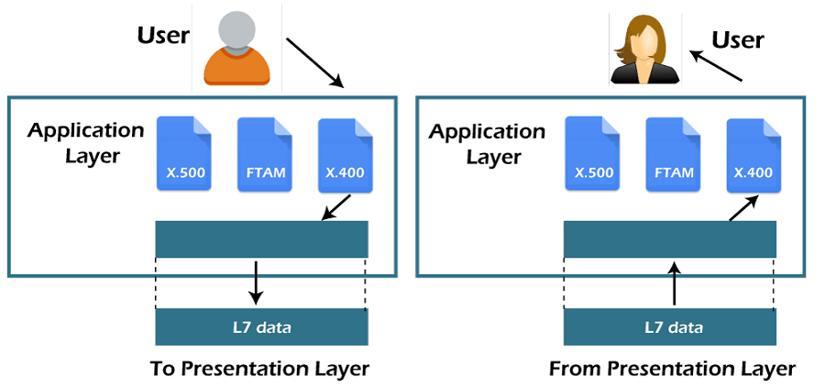
Layer 7: Application Layer
Interface with User and Application Programs: The Application Layer serves as the interface between the user or application and the lower layers of the OSI model. It allows users and applications to access network services and resources.
Data Representation and Encoding: It is responsible for data encoding and representation, ensuring that data from different sources can be understood and processed correctly. This includes character encoding, data compression, and data translation.
Data Exchange and Synchronization: The Application Layer ensures that data is exchanged correctly between different systems, including data synchronization and flow control mechanisms.
Application Protocols: It defines various application-level protocols that applications can use to communicate. Common examples include HTTP (for web browsing), SMTP (for email), FTP (for file transfer), and SNMP (for network management).
Support for Multiple Applications: The Application Layer can support multiple concurrent applications running on the same device. It manages communication between these applications and ensures that data is correctly delivered to the intended recipient.

Slide 11

Useful Resources
Networking Basics (Tutorial) - https://skillsforall.com/course/networking-basics?courseLang=en-US
Learn How Computer Networks Work with a Free 9-Hour Course - https://www.freecodecamp.org/news/free-computer-networking-course/

Slide 12


Slide 13

Thank you

